Slide 1
Spring Woods
Here is where your presentation begins

Slide 2
Contents of this template
You can delete this slide when you’re done editing the presentation
Fonts | To view this template correctly in PowerPoint, download and install the fonts we used
Used and alternative resources | An assortment of graphic resources that are suitable for use in this presentation
Thanks slide | You must keep it so that proper credits for our design are given
Colors | All the colors used in this presentation
Icons and infographic resources | These can be used in the template, and their size and color can be edited
Editable presentation theme | You can edit the master slides easily. For more info, click here
For more info: Slidesgo | Blog | FAQs
You can visit our sister projects: Freepik | Flaticon | Storyset | Wepik | Videvo

Slide 3
Table of contents
01
02
03
04
Name of the section
Name of the section
You can describe the topic of the section here
You can describe the topic of the section here
Name of the section
Name of the section
You can describe the topic of the section here
You can describe the topic of the section here

Slide 4
Introduction
Mercury is the closest planet to the Sun and the smallest one in the entire Solar System. This planet’s name has nothing to do with the liquid metal, since Mercury was named after the Roman messenger god. Despite being closer to the Sun than Venus, its temperatures aren’t as terribly hot as that planet’s. Its surface is quite similar to that of Earth's Moon, which means there are a lot of craters and plains
Speaking of craters, many of them were named after artists or authors who made significant contributions to their respective fields. Mercury takes a little more than 58 days to complete its rotation, so try to imagine how long days must be there! Since the temperatures are so extreme, albeit not as extreme as on Venus, and the solar radiation is so high, Mercury has been deemed to be non-habitable for humans

Slide 5
01
Name of the section
You can enter a subtitle here if you need it

Slide 6
Let’s have a look
Mercury is the closest planet to the Sun and the smallest one in the entire Solar System. This planet’s name has nothing to do with the liquid metal, since Mercury was named after the Roman messenger god. Despite being closer to the Sun than Venus, its temperatures aren't as terribly hot as that planet’s. Its surface is quite similar to that of Earth’s Moon, which means there are a lot of craters and plains. Speaking of craters, many of them were named after artists or authors who made significant contributions to their respective fields. Mercury takes a little more than 58 days to complete its rotation, so try to imagine how long days must be there!

Slide 7
The slide title goes here!
Do you know what helps you make your point clear? Lists like this one:
They’re simple
You can organize your ideas clearly
You’ll never forget to buy milk!
You can replace the image. Just right-click on it and select “Replace image”

Slide 8

Two ideas
Mercury
Venus
Mercury is the closest planet to the Sun and the smallest one in the Solar System. This planet’s name has nothing to do with the liquid metal
Venus has a beautiful name and is the second planet from the Sun. It’s hot and is the second-brightest natural object in the night sky

Slide 9
Three ideas
Mercury
Venus
Mercury is the closest planet to the Sun and the smallest one in the Solar System
Venus has a beautiful name and is the second planet from the Sun
Mars
Despite being red, Mars is actually a cold place. It’s full of iron oxide dust

Slide 10
Six different ideas
Mercury
Venus
Mars
Mercury is the smallest planet in the Solar System
Venus is the second planet from the Sun
Despite being red, Mars is actually a cold place
Jupiter
Saturn
Neptune
Jupiter is the biggest planet in the Solar System
Saturn is composed of hydrogen and helium
Neptune is the farthest planet from the Sun

Slide 11
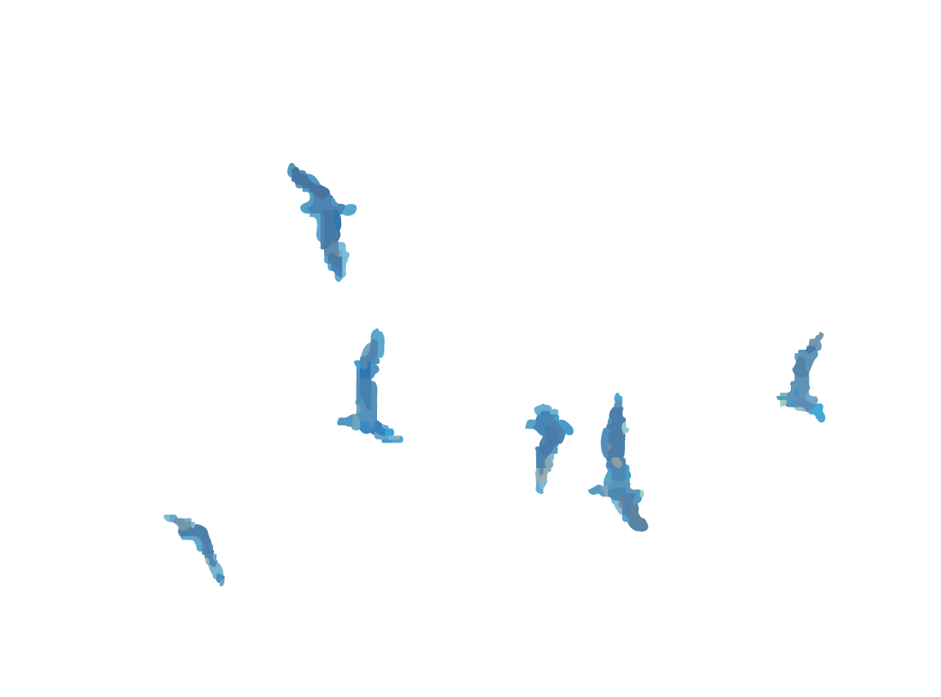
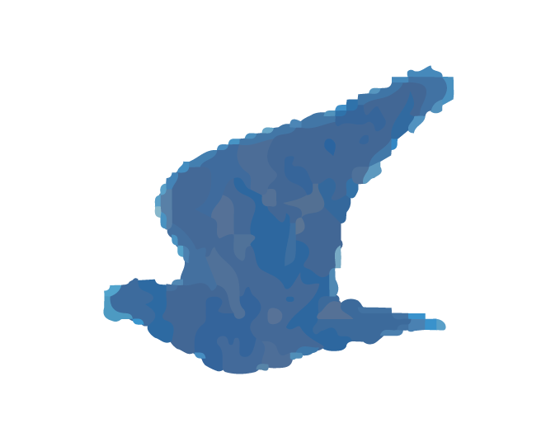
Awesome words

Slide 12

Product demo
You can replace the image on the screen with your own work. Just right-click on it and select “Replace image”

Slide 13
This is a map
Neptune
Neptune is the eighth planet from the Sun
Mars
Mars is actually a very cold place
Jupiter
Jupiter is the biggest planet of them all
Mercury
Mercury is the closest planet to the Sun
Venus
Venus has extremely high temperatures

Slide 14
Our history
Despite being red, Mars is actually a cold place
Mercury is the closest planet to the Sun
Neptune is the farthest planet from the Sun
Mars
Mercury
Neptune
Saturn
Jupiter
Saturn is a gas giant with several rings
Jupiter is the biggest planet of them all

Slide 15
You can use an infographic
Mars
Venus
Mars is actually a very cold place
Venus has extremely high temperatures
Jupiter
Earth
Jupiter is the biggest planet of them all
Earth is the only planet known to harbor life
Neptune
Saturn
Neptune is the eighth planet from the Sun
Saturn is a gas giant and has several rings

Slide 16
This is a table
Main features | Description
Temperature | Soft and increasing
Vegetation | Renewal of vegetation with flowers and new shoots
Length of day | Longer days and shorter nights
Animal activity | Increase in animal activity

Slide 17

This is a graph
20%
Venus
Venus has extremely high temperatures
30%
Neptune
Neptune is the eighth planet from the Sun
50%
Saturn
Follow the link in the graph to modify its data and then paste the new one here. For more info, click here
Saturn is a gas giant and has several rings

Slide 18
21 million
Big numbers catch your audience’s attention

Slide 19
Thanks!
Do you have any questions?
youremail@freepik.com
+34 654 321 432
yourwebsite.com
Please keep this slide for attribution

